Slide 1
Github: Repositories & Portfolio Websites
James R. Bradley

Slide 2
Github
We will be interacting with github.com in this session, so let’s breakdown the name
git
Version control software
hub
The effective center of an activity, region, or network
Source: google.com
github.com
permits you to use git, while serving as a hub from which you can distribute files

Slide 3
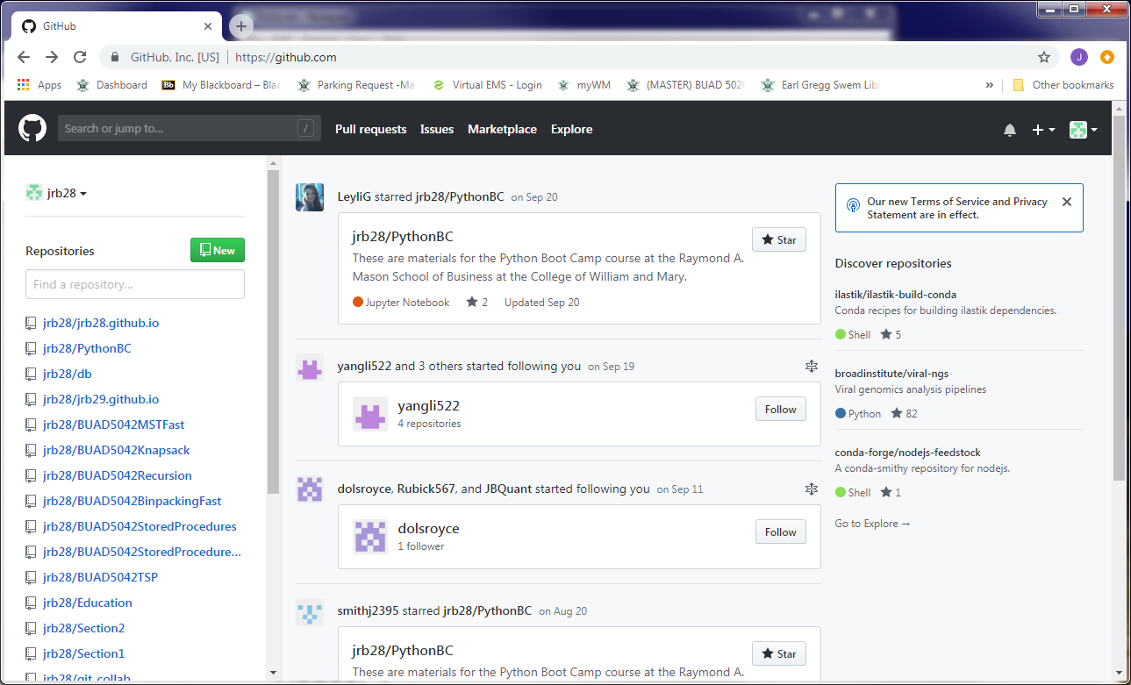
Github
Here is my github.com page
Multiple repositories (repos)
For distributing files

Slide 4
Github
Another use for github.com
Publish a portfolio of your work
Useful in your job search

Slide 5
Github Repositories (Repos)

Slide 6


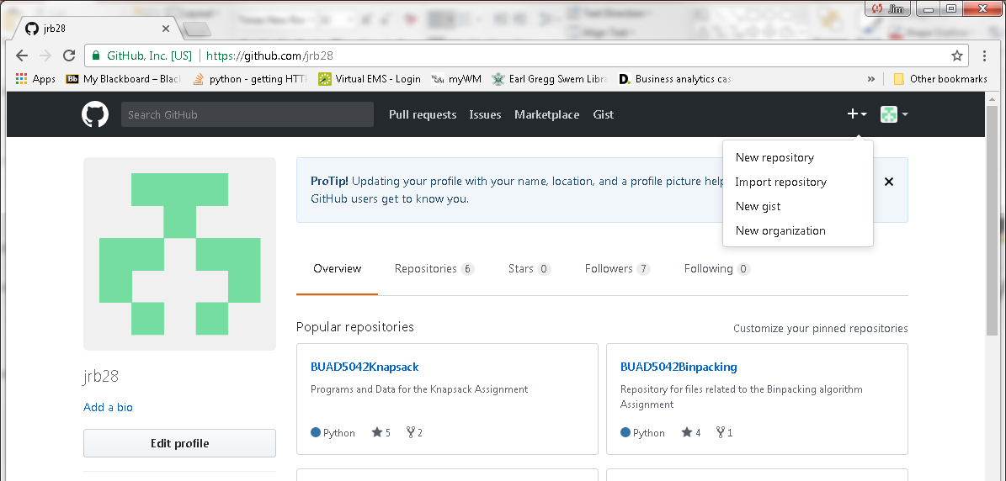
Github Repositories
Create account: go to https://github.com/
Create a repository

Slide 7
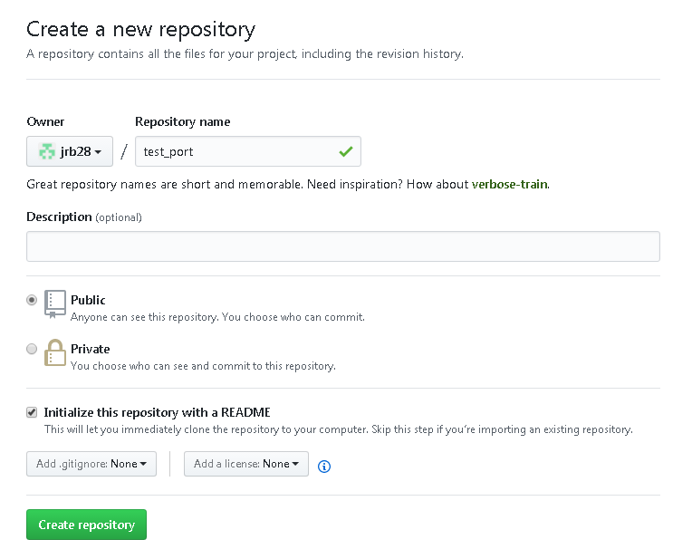
Github Repositories
Choose Public repository (free)
Choose Initialize this repository with a README

Slide 8
Github Repositories
Click on Upload Files button
Select files or drag to browser
Change commit message if desired
Click on Commit Changes button

Slide 9
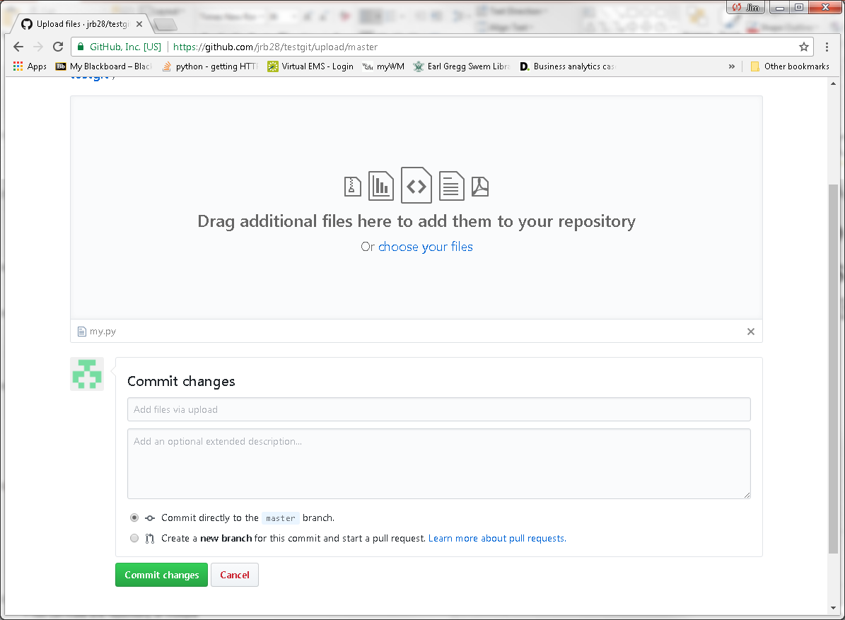
Github Repositories

Slide 10
Portfolio in Github Repository
Repos can be a part of your portfolio
Publish all code and documents on a single project in a repo
Code, Jupyter notebooks, presentations, reports, etc.
Jupyter notebooks in repos are rendered as html web pages
Opportunity to show your work and explain what you did
Use multiple repos
Each focuses on a different topics, job, or project
Organize your files within folders for neatness
All code in a folder
Readme document in root folder

Slide 11
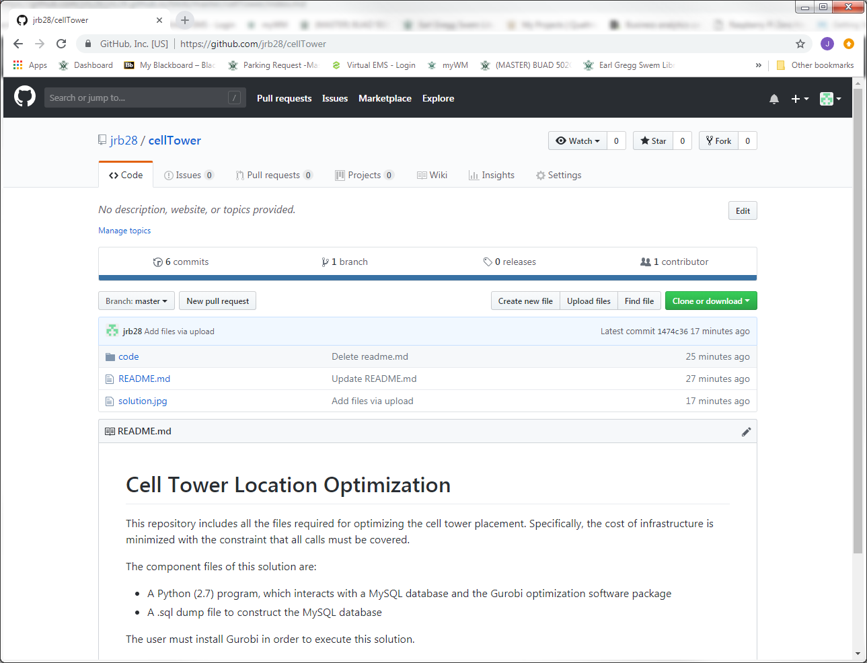
Portfolio in Github Repository
Example Github repo

Slide 12
Github Portfolio Web Sites

Slide 13
Getting Started
Github.com also allows a web page
Create a GitHub repository with this name:
username.github.io
Browse to your web page
username.github.io
Edit your site:
github.com/username/username.github.io
View your site:
username.github.io

Slide 14
Getting Started
Choose theme
Download zip file
Edit index.md using text editor
A markdown file
Markdown is translated to HTML with style documents
A .scss file in _sass folder
Upload all files & folders to
github.com/username/username.github.io
You just created your web site
Need to customize it

Slide 15
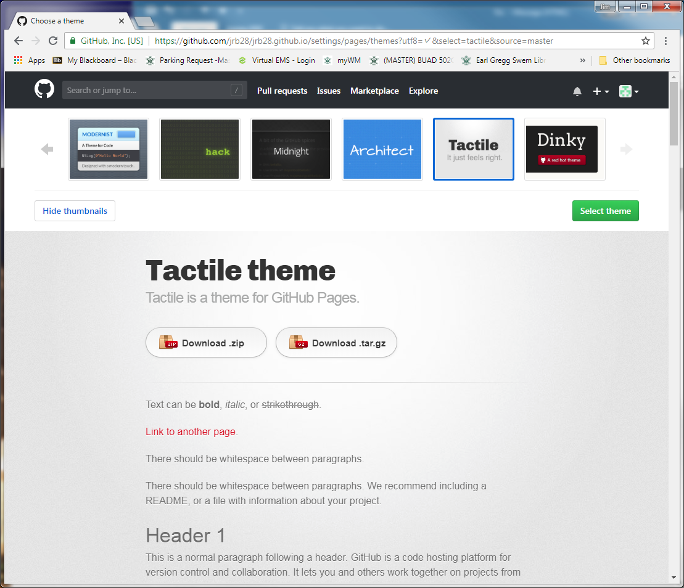
Portfolio Website on Github

Slide 16
Website Structures
index.md in root folder is the web site origin
Web site structure strategies
Create project or topics web pages from markdown documents
Link to a variety of content
Repository pages (e.g., code)
Jupyter notebooks
Download and visual rendering
Images
Videos

Slide 17
Portfolio Website on Github
Jupyter notebooks
In repositories
.ipynb files are rendered as HTML
Non-functional
In github web site viewed through web browser
Save .ipynb notebooks as HTML for HTML view
.ipynb files are automatically downloaded otherwise

Slide 18
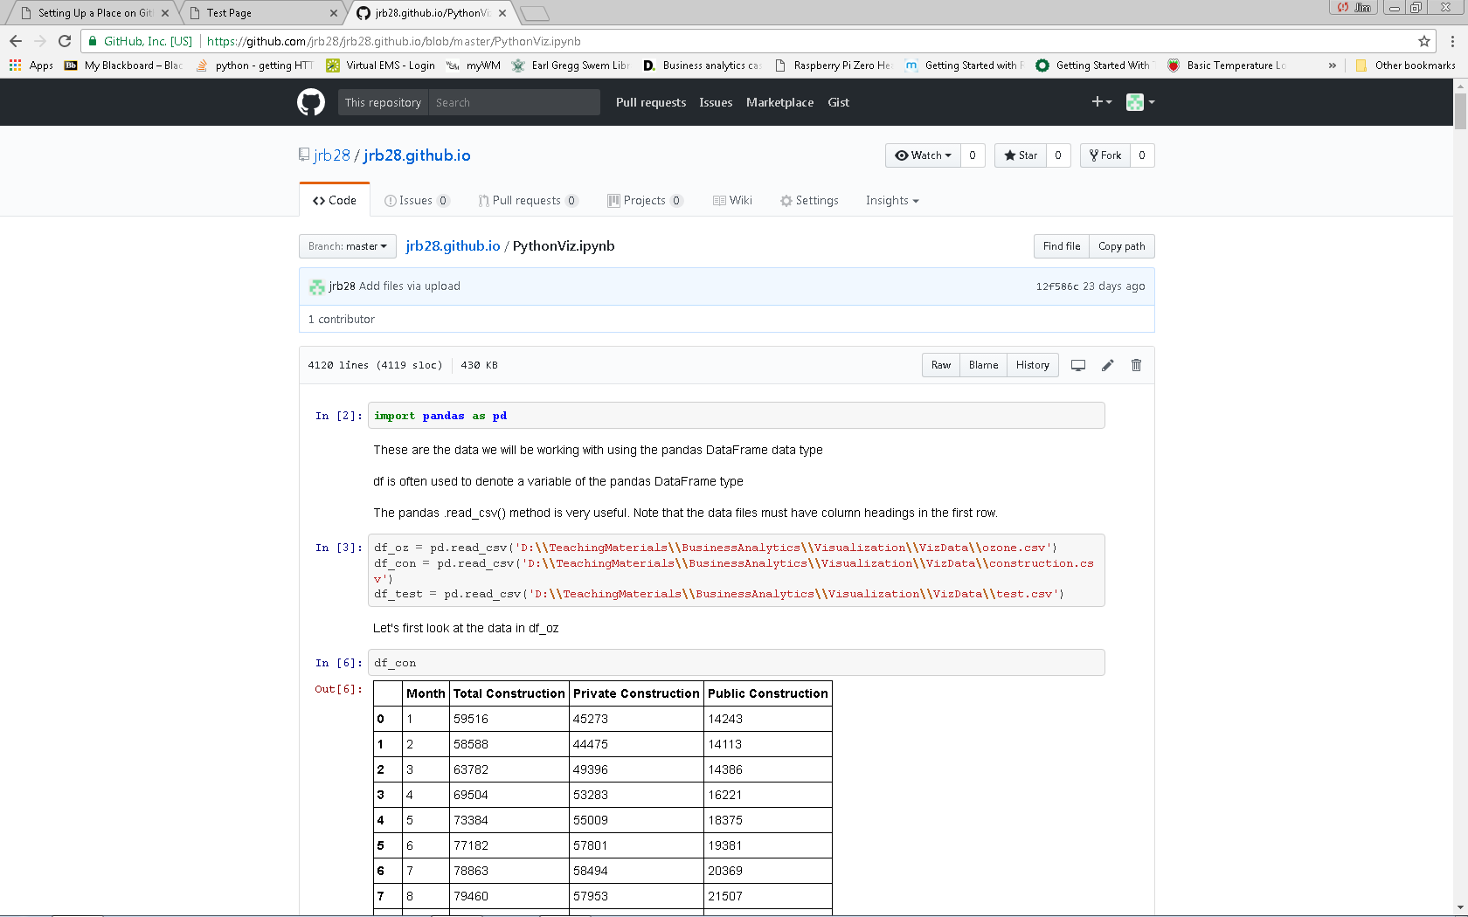
Portfolio Website on Github
Jupyter notebooks viewed in repository

Slide 19
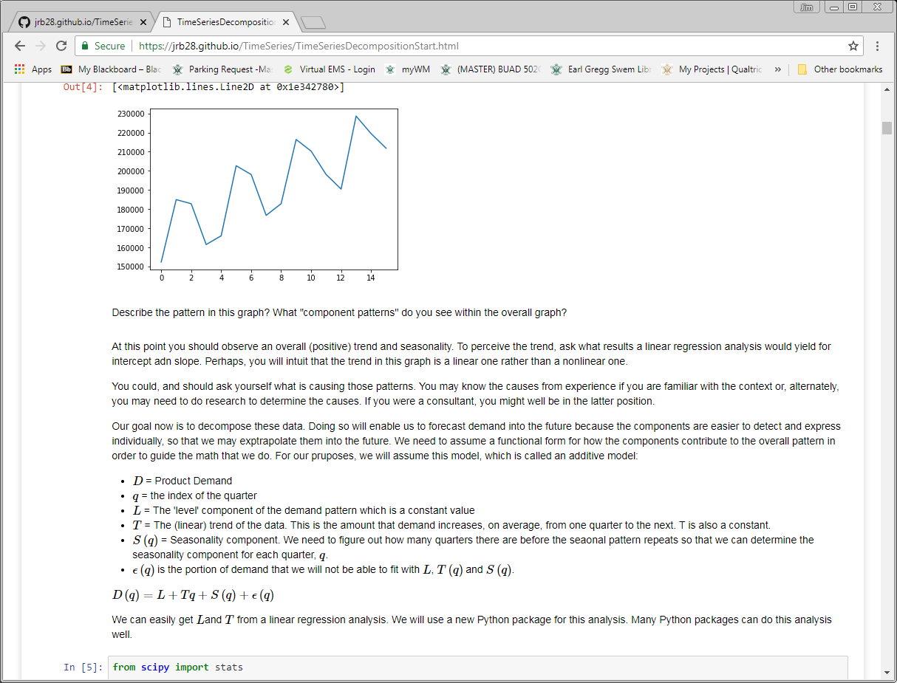
Portfolio Website on Github
Jupyter from a Github web page
Notice URL indicates .html file

Slide 20
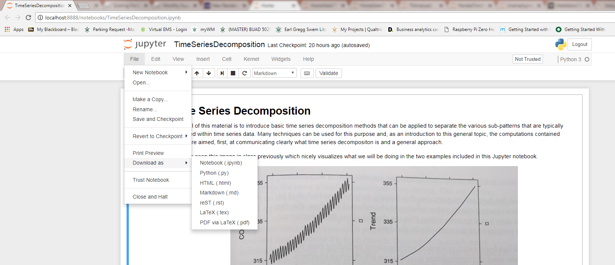
Portfolio Website on Github
How to convert Jupyter notebooks to html

Slide 21
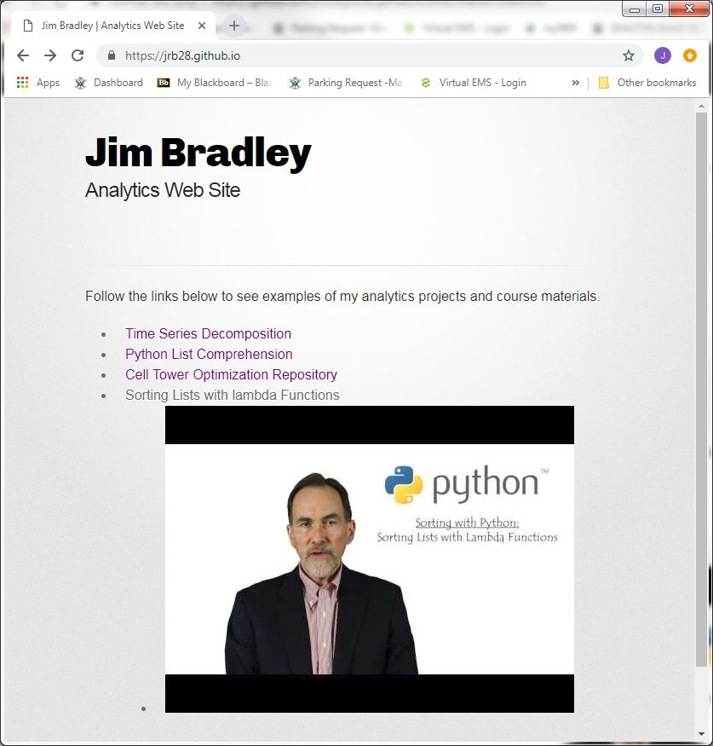
Portfolio Website on Github
View website xxx

Slide 22
Xxx tour of my site

Slide 24
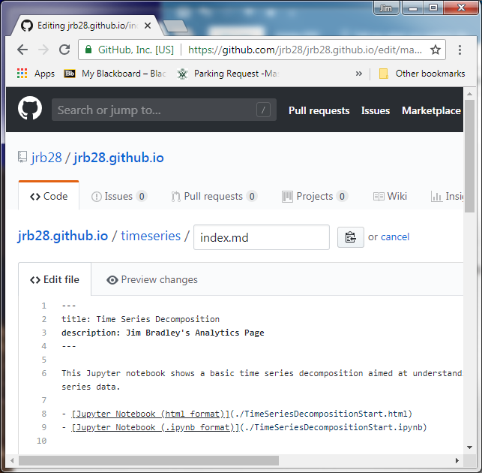
Tips
Each page should have a title and description between the set of three dashes
Edit .scss file in _sass folder for format revisions

Slide 25
Tips
There is a lag from when you load files and edit .md files and when they can be viewed online

Slide 26
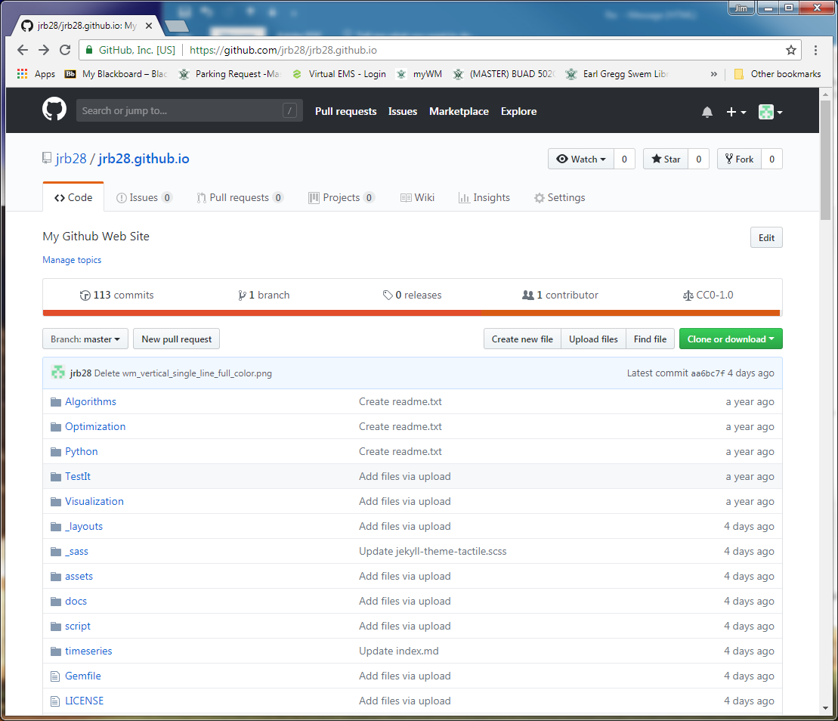
Tips
Manage website
Add files just like other repositories
Uploading content by dragging files from File Explorer to Github folder
Commit changes

Slide 27
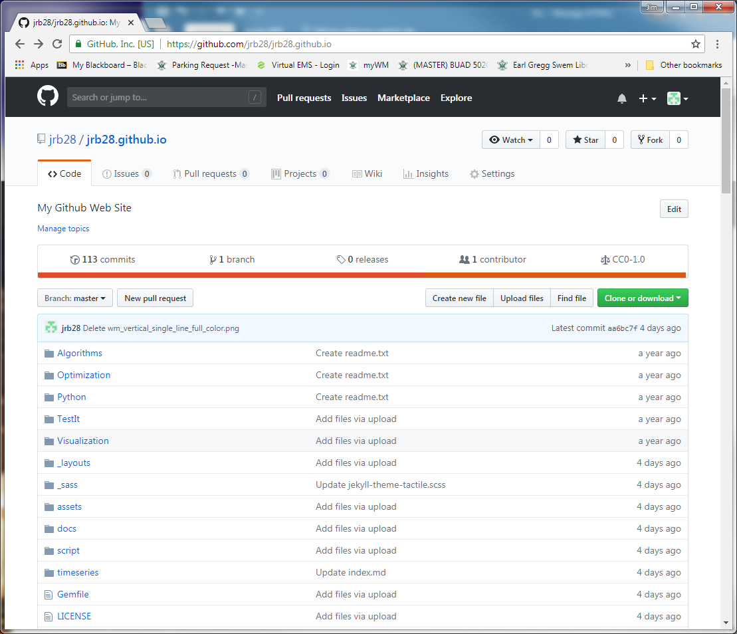
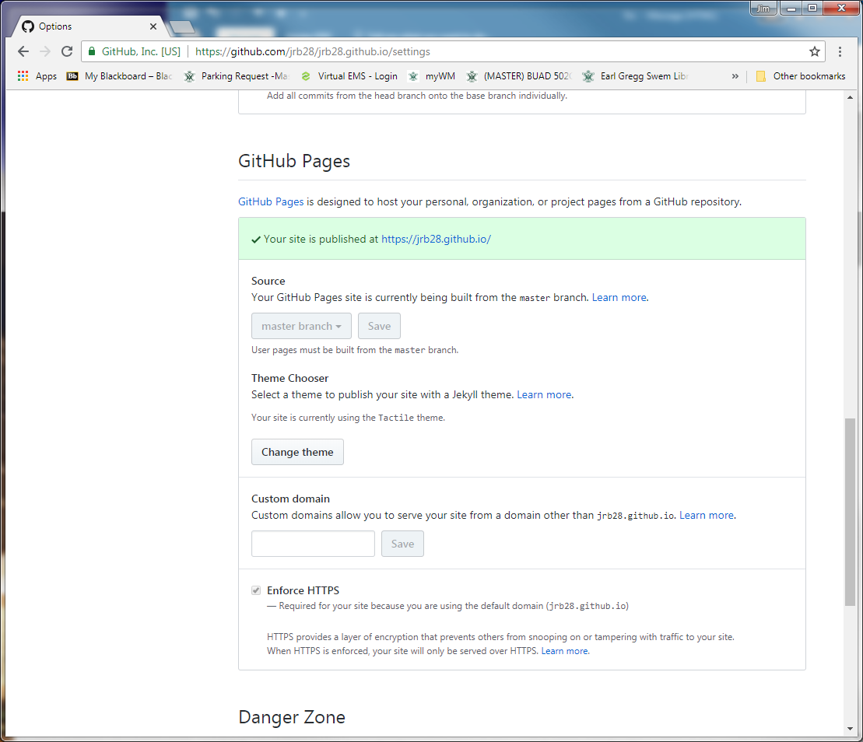
Tips
Change themes

Slide 28
Portfolio Website on Github
Resources & Ideas
https://dannguyen.github.io/github-for-portfolios/
See first tutorial for basics of setting up a Github web page
http://blog.udacity.com/2016/02/how-to-build-a-data-analysis-portfolio-that-will-get-you-hired.html
https://techbeacon.com/what-do-job-seeking-developers-need-their-github
https://help.github.com/articles/working-with-jupyter-notebook-files-on-github/
Jupyter and Github
https://www.dataquest.io/blog/how-to-share-data-science-portfolio/

